Slide 1
Access Controls
Linux 1 Day 2

Slide 2
Class Objectives
By the end of today’s class, you will be able to:
Audit passwords using john.
Elevate privileges with sudo and su.
Create and manage users and groups.
Inspect and set file permissions for sensitive files on the system.

Slide 3
Activities
In the activities throughout this week, we are auditing a malfunctioning server.
In previous exercises, we collected important files, stopped malicious processes and installed tools to facilitate the audit.
Today, we’ll look at user access controls, beginning with passwords.
In the previous class, we made a copy of /etc/shadow, which contains the passwords
on a system.
These passwords are obfuscated with a hashing function, meaning we can’t read them
in plain text...yet.

Slide 4
A Brief Introduction to Hashes and Password Cracking

Slide 5

Password Hashes
A hash is a cryptographic function that takes data as input and translates it to a string of different, random-looking data.
My Plain Text Password My Password Hash
ApPles2Orang3s93
579de3a38386c62a1eca4600e3882b8b
A hash will always output the same string for the same input data.

Slide 6

Password Hashes
The hash is stored in the shadow file.
When a user logs in, the hash of the submitted password is compared to the hash stored in etc/shadow.
If the hashes match, the user’s logged in.
Notes:
shutterstock_782515144

Slide 7
Password Cracking
A hash is a cryptographic function that takes data as input and translates it to a string of different, random-looking data.
My Plain Text Password My Password Hash
ApPles2Orang3s93
579de3a38386c62a1eca4600e3882b8b
Password cracking tools cannot reverse a password hash.

Slide 8
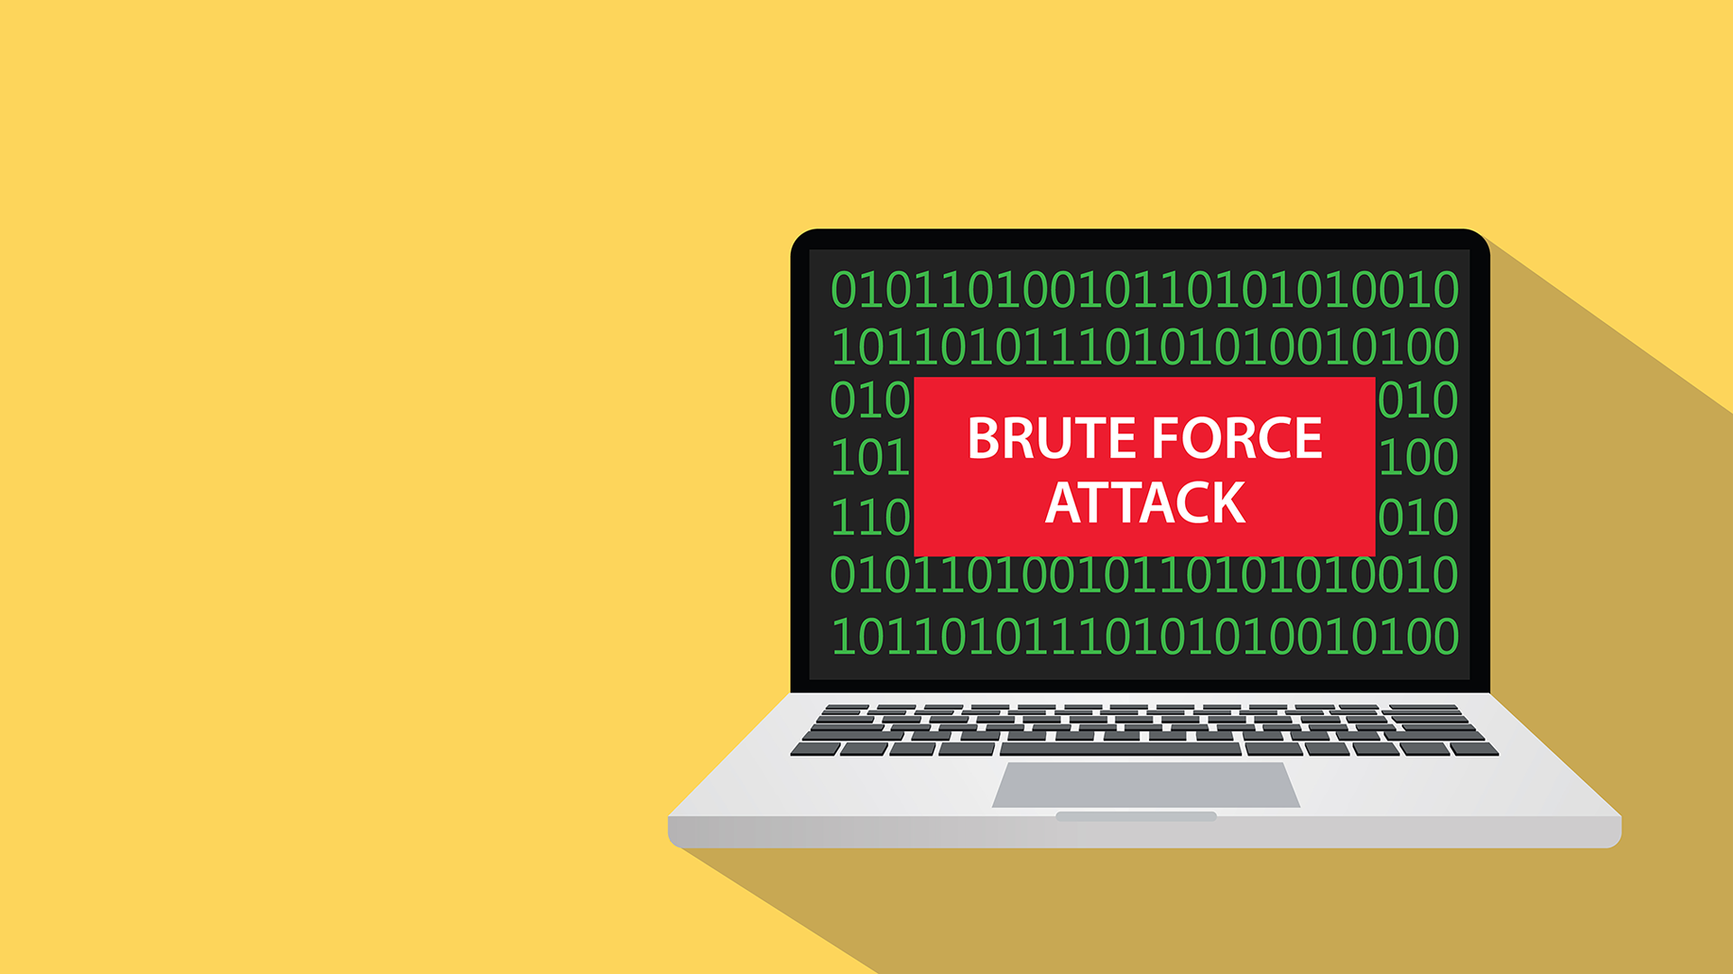
Password Hashes
Password cracking tools cannot reverse a password hash.
Instead, they use a wordlist of potential passwords and create hashes for each one.
This form of password hacking is called a brute force attack.
Notes:
shutterstock_599075294

Slide 9
The more random and lengthy the password, the longer it will take to crack.

Slide 10
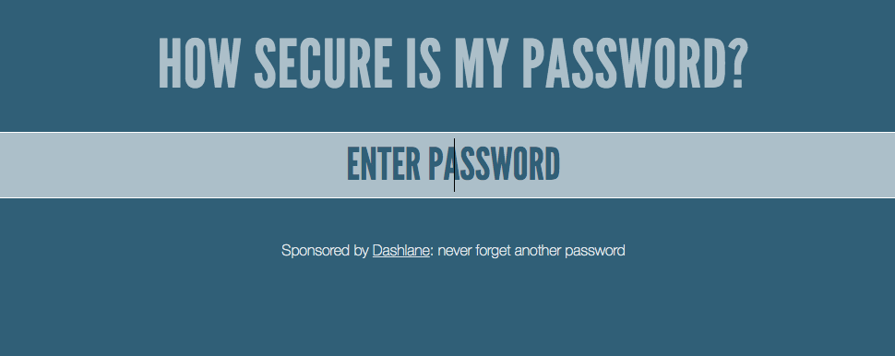
How secure is my password?
Go to howsecureismypassword.net.

Slide 11
Secure Password Takeaways
If a system requires passwords of only sixteen characters, the password will be relatively strong, even if it contains words.
Add a few extra characters and it will become exponentially more secure.
In contrast, if using all random characters, a password still must be at least 10 characters to be very effective.

Slide 12

Managing Passwords as Administrators
As administrators, we can do the following to control and secure passwords:
We may not be able to see a user’s password, but we can see when they last reset it.
Making the password expire after a set time, so users will have to reset it.
We can also set length, number, and character requirements.
The only tools we need are chage (to change when a password expires) and nano (to edit the settings inside the /etc/security/pwquality.conf file).

Slide 13
chage
chage allows us to change the number of days between password changes for each user.
The system will then use this information to determine when a user must change their password.
Some common options to use with chage:
chage -l | Shows the account aging info.
chage -M | Sets the number of days between password expirations.
chage -W | Sets the number of warnings the user gets before the change must be made.
chage -d 0 | Forces an immediate password change.

Slide 14
Demo Scenario
In the following demo, we will:
Change the maximum number of days between password changes to 90.
Change the number of days of warning before a password expires to 10.
Force Billy's current password to expire immediately.
Ensure that the new password differs from an old password by at least one character.
Ensure that the new password does not contain common dictionary words.
Set the minimum character length of new passwords to 12.
Set the minimum character types in a password to two.

Slide 15
Password Expiration Demo

Slide 16
Activity: Let’s Talk to John
In this activity, you will continue your role as a junior administrator auditing a system. Now, the focus is on passwords.
You will use john, which we installed in the previous class, to crack the password hashes for all of the users on our system.
Then, you will use the appropriate chage commands to set some password expirations and edit the pwquality.conf file to force stronger passwords.
15 Minutes

Slide 18
Privileges, root, sudo, and su

Slide 19

We’ve used sudo for several commands in this unit.
Why do you think some commands require sudo and others don’t?

Slide 20
Privileges and Users
Why do we need to use sudo for some commands and not others?
Users
Groups
Root
Every file and program on a Linux system has permissions.
These permissions tell the system which users can access a file or run a program.
Users can be placed in groups, which can have their own permissions.
File and program permissions apply to all users except the root.
The root user (or super user) has complete access to the system and can perform any task.

Slide 21
Root Access
When attackers try to gain access to a system, they often try to gain root access.
Secure Linux systems do not allow anyone to log in as the root user on the system.
sudo (superuser do) can grant a user root privileges for one command.
When the one sudo command is done, the user is reverted to their normal access.
sudo can also control which commands the user can run as root.

Slide 22
sudo

Slide 23
Sudo Demo Summary
In the previous demonstration, we covered the following commands:
whoami | Determines the current user.
su | Switches to another user, in this case the root user.
sudo | Invokes the root user for one command only.
sudo -l | Lists the sudo privileges for a user.
visudo | Edits the sudoers file.

Slide 24
Activity: Sudo Wrestling
In this activity, you will continue your role as a junior administrator auditing the system:
The senior administrator has asked you to audit the system for sudo and root access, making sure no users other than the admin user have access to any sudo use.
You must log in as each user, check their privileges, edit the sudoers file, and look for anything else suspicious.
15 Minutes

Slide 26
Sudo Wrestling Review
In order to complete this activity, we needed to:
View the sudo privileges for each user on the system.
Find a user that has sudo access for the less command.
Log in as that user.
Verify that the user has the ability to drop out of less and into a root shell.
Audit and edit the sudoers file to remove any access that shouldn’t be there.

Slide 27
Users and Groups

Slide 28

Users and Groups
Sales
As noted, users on a Linux system can be added to groups.
Linux has the ability to create groups of users for functions like file and service sharing.
Marketing
If a company has different departments, like Sales, Accounting, and Marketing, a Linux admin can create a group for each department. Only users in each group can access files owned by the group.
Accounting
Notes:
shutterstock_422379706

Slide 29

Users and Groups
A system admin must know how to to add and remove users to a system, add and remove groups, and add or remove users from groups.
Soon we’ll discuss commands specifically used for user and group management.
But first, let’s see how Linux identifies users and groups in the system.
Notes:
shutterstock_412967095

Slide 30
id command
Linux identifies users and groups in the system using the id command:
Linux associates a specific number with each user, known as the user ID (UID).
When Linux needs to identify a user, it uses the UID, not the username.
System users have a UID that is less than 1000.
Standard users have a UID that is greater than 1000.
The root user always has the UID of 0.

Slide 31
id

Slide 32


Users and Groups Demo Scenario
In the upcoming demo, we’ll dive into more actions for user and group management using the following scenario:
Your company recently made changes to the developer team.
Mike, a lead developer, has left the company.
Joseph has joined as a new junior developer.

Slide 33




Users and Groups Demo Scenario
The company’s Linux system has never been set up properly with a developers group. Instead, Mike was part of the general group.
General Group

Slide 34
Users and Groups Demo Scenario
As the sysadmin for this system, you need to remove Mike from the general group, remove the general group, and delete Mike from the system.
x
x
General Group
Mike, a lead developer, has left the company.

Slide 35


Users and Groups Demo Scenario
Then, you need to add Joseph to the system, create a developers group, and add Joseph to this group.
+
+
Developers Group
Joseph has joined as a new junior developer.

Slide 36
Users and Groups Scenario
To accomplish these tasks, we will use the following commands:
groups | Get group info for the user mike.
usermod | Lock Mike’s account to prevent him from logging in.
usermod | Remove the user mike from the general group.
deluser --remove-home | Delete the user mike.
delgroup | Delete the general group.
adduser | Create the user joseph.
addgroup | Create a developer group.
usermod | Add the user joseph to the developer group.
X
+

Slide 37
Users and Groups

Slide 38
Activity: Users and Groups
Your senior administrator has asked you to audit all the users and groups on the system.
You must create a new group for the standard users and remove users from the sudo group.
In the previous activity, you found some malicious users. Now, you will remove them from the system entirely.
15 Minutes

Slide 40
Users and Groups Review
To complete this activity, we had to:
Check every user’s UID and GID.
Make sure that only the sysadmin account belonged to the sudoers group.
Remove any users from the system that shouldn’t have been there.
Verify that all non-admin users were part of the group developers.
Remove the suspicious hax0rs group.

Slide 41
Access Controls

Slide 42
Like Google Docs,
Linux has access controls,
granting permission to access documents and files on a host.

Slide 43
Managing Access Controls in Linux
Linux categorizes files, programs, and directories as items.
Item

Slide 44
Managing Access Controls in Linux
Each item has privileges set for the owner of the item, the group associated with the item, and others.
Item
Owner
Group
Other

Slide 45
Managing Access Controls in Linux
Each item has privileges set for the owner of the item, the group associated with the item, and others.
Item
Owner
Group
Other
Typically the user who created the item.
(But this can be changed).
Typically the primary group associated with the owner.
(This can also be changed.)
Everyone who is not the owner, and not in the group.

Slide 46
Managing Access Controls in Linux
For each of these categories, there are three actions that we can allow or prevent:
read, write, execute.
Item
Owner
Group
Other
Can the owner read this item?
Can the group read this item?
Can others read this item?
Can the owner write this item?
Can the group write this item?
Can others write this item?
Can the owner execute this item?
Can the group execute this item?
Can others execute this item?

Slide 47
Managing Access Controls in Linux
Assigning these permissions is called Discretionary Access Control (DAC).
It is discretionary because permissions can pass from one item to another.
Item
Owner
Group
Other
Can the owner read this item?
Can the group read this item?
Can others read this item?
Can the owner write this item?
Can the group write this item?
Can others write this item?
Can the owner execute this item?
Can the group execute this item?
Can others execute this item?

Slide 48
Permissions Demo
In the upcoming demo, we’ll create a file and a directory, observing default permissions. Then, we will change the permissions to deny certain groups and users access.
To read and manipulate these file permissions, we’ll use these commands:
ls -l | Show the permissions info.
chmod | Change the permissions info.
chown | Change the owner and group of a file.

Slide 49
Permissions

Slide 50
Inspecting File Permissions
-rw-r--r--
Item type (- for file, d for directory)

Slide 51
Inspecting File Permissions
-rw-r--r--
Owner permission (in this case, read and write)
Item type

Slide 52
Inspecting File Permissions
-rw-r--r--
Group permission (read)
Owner permission (in this case, read and write)
Item type

Slide 53
Inspecting File Permissions
-rw-r--r--
Other / world permission (read)
Group permission (read)
Owner permission (in this case, read and write)
Item type

Slide 54
Changing File Permissions
File permissions can be set using two different notations: symbolic and octal.
Symbolic Notation
r | read
w | write
x | execute
rwx rw- r--
User can read, write execute
Group can read and write
Others can read

Slide 55
Changing File Permissions
File permissions can be set using two different notations: symbolic and octal.
Octal Notation
 | 4 | 2 | 1
0 | - | - | - | No permission
1 | - | - | x | Only execute
2 | - | w | - | Only write
3 | - | w | x | Write and execute
4 | r | - | - | Only read
5 | r | - | x | Read and execute
6 | r | w | - | Read and write
7 | r | w | x | Read, write, and execute
rwx rw- r--
4 + 2 + 1
4 + 2 + 0
4 + 0 + 0
7
6
4
764
User can read, write execute
Group can read and write
Others can read

Slide 56
Activity: Access Controls and Permissions
In this activity, you will inspect and set file permissions on a few of the most sensitive items on a Linux system.
In the previous activity, you cleaned up the system groups and removed all the malicious users from the system.
Now you need to make sure a few items are locked down by checking and modifying their permissions.
15 Minutes

Slide 58
Access Controls and Permissions Review
In order to complete this activity, we needed to:
Set permissions 600 on /etc/shadow (rw for root only.)
Set permissions 600 on /etc/gshadow (rw for root only.)
Set permissions 644 on /etc/group (rw for root and r for everyone else.)
Set permissions 644 on /etc/passwd (rw for root and r for everyone else.)
Verify all accounts have passwords.
Verify that no users other than root have UIDs of 0.
Provide a list of your findings in the research directory.

Slide 59
Any Questions?

